Slide 1
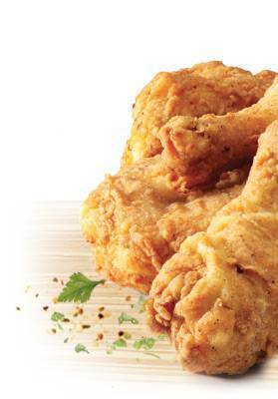
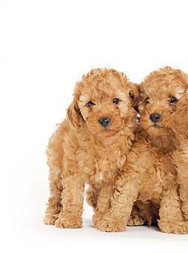
Pups or Poultry?
Group 1
Presenter: Erica Lynn Kilbride
Team Members: Chi Zhang, Zhehao Liu, Yixin Sun, Jingdan Zhao, Qing Yin

Slide 2
Agenda
Tune baseline model under SIFT extraction
Other models under SIFT extraction
New feature extractions and comparison
Models under best feature extraction
Select optional feature extraction method with model

Slide 3
Features & Models
Features:
SIFT
SURF
SURF+Color Distribution
CNN (convolutional neural network, we only try this feature set during training without final applying)
Models:
GBM(gradient boosted machine)
LDA/QDA (too simple that we ignore after try)
Xgboost
SVM (support vector machine)

Slide 4
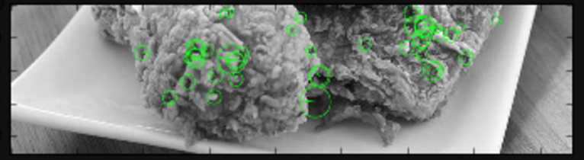
Features: SURF
Speeded Up Robust Features
Inspired by SIFT
MiniBatchK-means with 5500 centroids

Slide 5
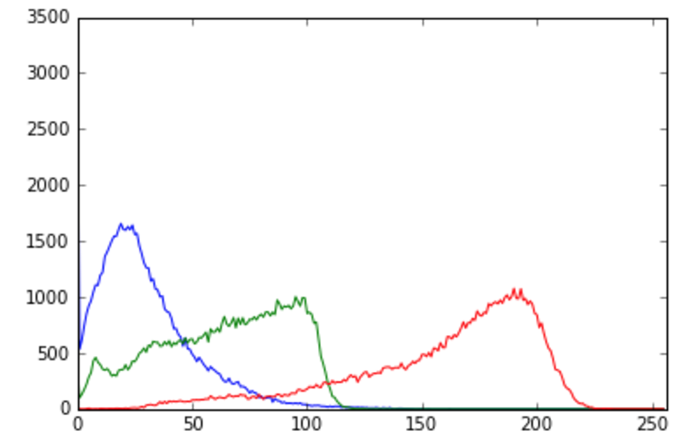
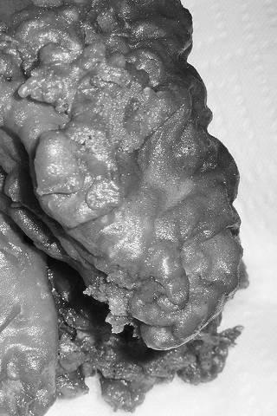
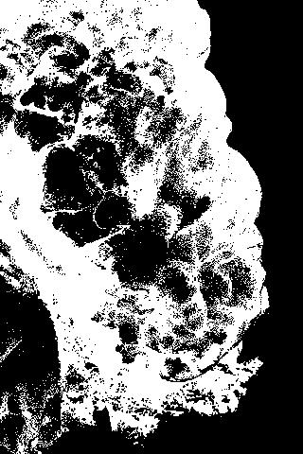
Features: Color Distribution
By applying binary threshold on the image, we approximately regard all the area in black as background and exclude it from future calculation of color distribution.
Here we get the distribution of color index distribution on both R,G,B scale, and use it as additional feature to SURF.

Slide 6
Features: CNN
Load images into SFrame(GraphLab data structure)
Using pre-trained model² for ImageNet by Alex Krizhevsky to extract features
Scale features to have zero mean and and unit standard deviation

Slide 7
SVM Model
SVM: In machine learning, support vector machines are supervised learning models with associated learning algorithms that analyze data used for classification and regression analysis.
When we tune SVM model, we test different values of cost and gamma.

Slide 8
Xgboost Model
It is a machine learning technique for regression and classification problems, which produces a prediction model in the form of an ensemble of weak prediction models, typically decision trees.
When we tune Xgboost model, we test different values of eta and max_depth.

Slide 9
Results Comparison
Baseline model: Select best parameter
Feature | Model | Test Accuracy (CV = 5-fold) | Timing | Accuracy/Timing
SIFT | GBM (depth = 1, trees = 2000) | 66.25% | 1117 | 0.000593107
SIFT | GBM (depth = 3, trees = 2000) | 67% | 1452 | 0.000461401
SIFT | GBM (depth = 5, trees = 1955) | 69% | 1860 | 0.000370968
Adding features: select best feature collection given parameter
Feature | Model | Test Accuracy (CV = 5-fold) | Timing | Accuracy/Timing
SIFT | GBM (depth = 1, trees = 2000) | 66.25% | 1117 | 0.000593107
SIFT + Color | GBM (depth = 1, trees = 2000) | 78% | 1311 | 0.00059497
SURF + Color | GBM (depth = 1, trees = 2000) | 80.25% | 1251 | 0.000641487
Best features: Select best model
Feature | Model | Test Accuracy (CV = 5-fold) | Timing | Accuracy/Timing
SURF + Color | Linear Kernel SVM (cost = 10) | 79% | 154 | 0.00512987
SURF + Color | Radial Kernel SVM (cost = 10, gamma = 10) | 80% | 625 | 0.00128

Slide 10
Results in detail - GBM
Features | Time | Tuning Parameter | Training Accuracy | Testing Accuracy
SIFT | 3351s | Depth=1, tree=2000 Depth=3, tree=2000 Depth=5, tree=1955 | 87.2% 98.6% 100% | 66.25% 67% 69%
SIFT + Color | 5801s | Depth=1, tree=2000 Depth=3, tree=1927 Depth=5, tree=1205 | 87.1% 94.4% 95.4% | 78% 78% 78.25%
SURF + Color | 3760s | Depth=1, tree=2000 Depth=3, tree=1831 Depth=5, tree=1212 | 90.6% 95.7% 96.6% | 80.25% 79.25% 81.75%
CNN | 4154s | Depth=1, tree=2000 Depth=3, tree=1957 Depth=5, tree=1463 | 100% 100% 100% | 98.0% 98.0% 97.75%

Slide 11
Results in detail - Xgboost
Features | Time | Testing Accuracy
SIFT | 20 minutes – 30 minutes | 70.5%
SURF | 20 minutes – 30minutes | 53.5%
SURF + Color | 30 minutes | 78%

Slide 12
Results in detail - SVM Linear Kernel
Feature | Time | Tuning Parameter | CV Accuracy | Testing Accuracy
SURF + Color | 154s | Cost = 0.1 | 71.9% | 79%
 |  | Cost = 0.5 | 75.6%
 |  | Cost = 1 | 77.3%
 |  | Cost = 5 | 81%
 |  | Cost = 10 | 81.3%
 |  | Cost = 50 | 80.4%

Slide 13
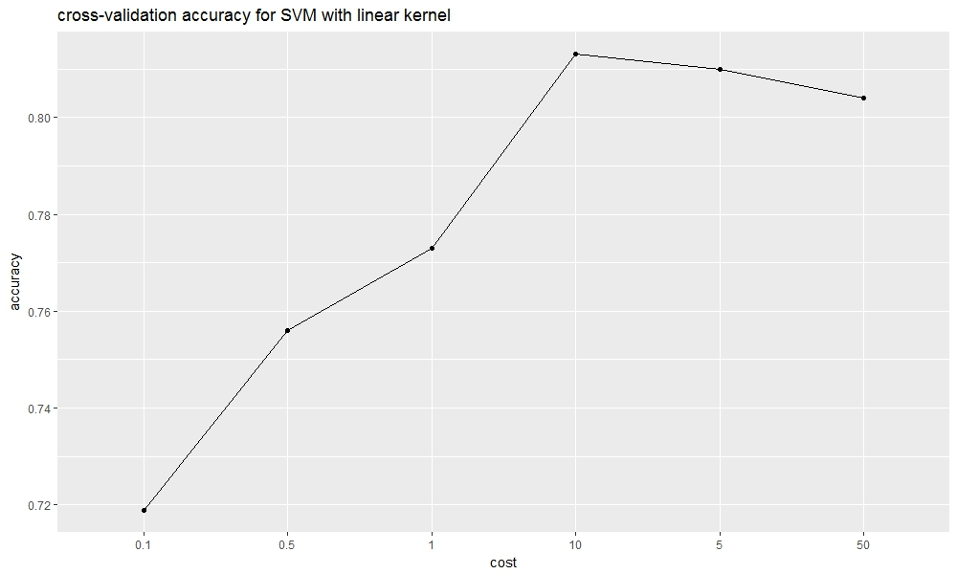
SVM Linear Kernel CV accuracy plot

Slide 14
Results in detail - SVM Radial Kernel
Feature | Time | Tuning Parameters and CV accuracy |  |  |  |  |  | Testing Accuracy
Surf + Color | 625s | Cost Gamma | 1 | 5 | 10 | 20 | 50 | 80
 |  | 0.01 | 0.522 | 0.718 | 0.742 | 0.76 | 0.777
 |  | 0.1 | 0.744 | 0.788 | 0.799 | 0.811 | 0.82
 |  | 1 | 0.81 | 0.827 | 0.826 | 0.836 | 0.824
 |  | 5 | 0.833 | 0.835 | 0.846 | 0.842 | 0.831
 |  | 10 | 0.834 | 0.846 | 0.842 | 0.837 | 0.831

Slide 15
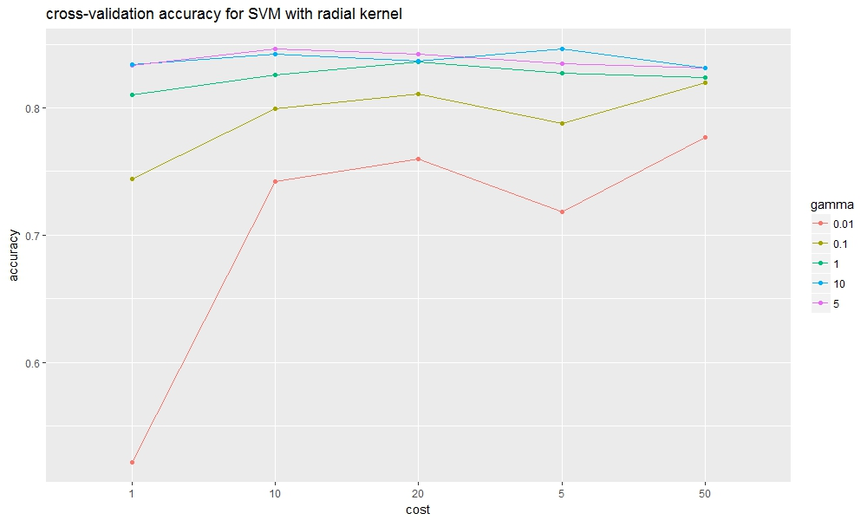
SVM Radial Kernel CV accuracy plot

Slide 16
Final feature set and models
Final feature set we use: SURF + Color
Final models we use:
for baseline: GBM
for advanced: SVM (shorter time and
higher accuracy)

Slide 17
Thank you!

